Slide 1
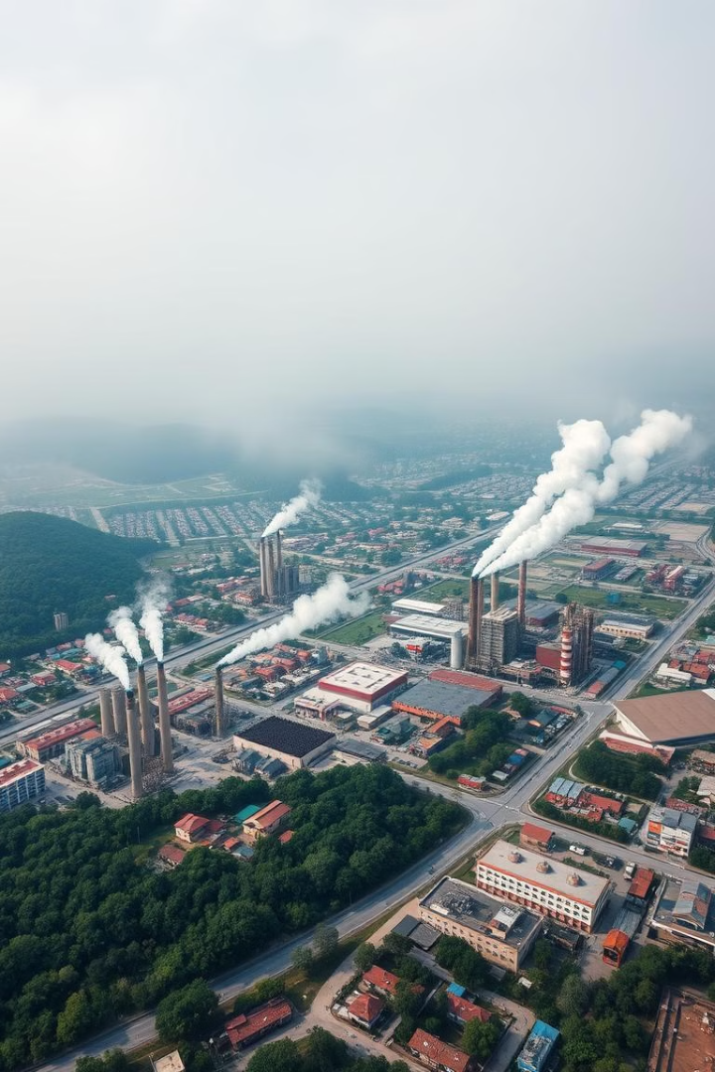
Air Pollution in Dilovası : Solving Environmental Problems Using Community Mapping
Dilovası, a prominent industrial zone in Turkey, faces a persistent challenge: air pollution. This presentation delves into the sources of air pollution in Dilovası, its detrimental environmental impacts, and potential solutions to mitigate these issues.

Slide 2
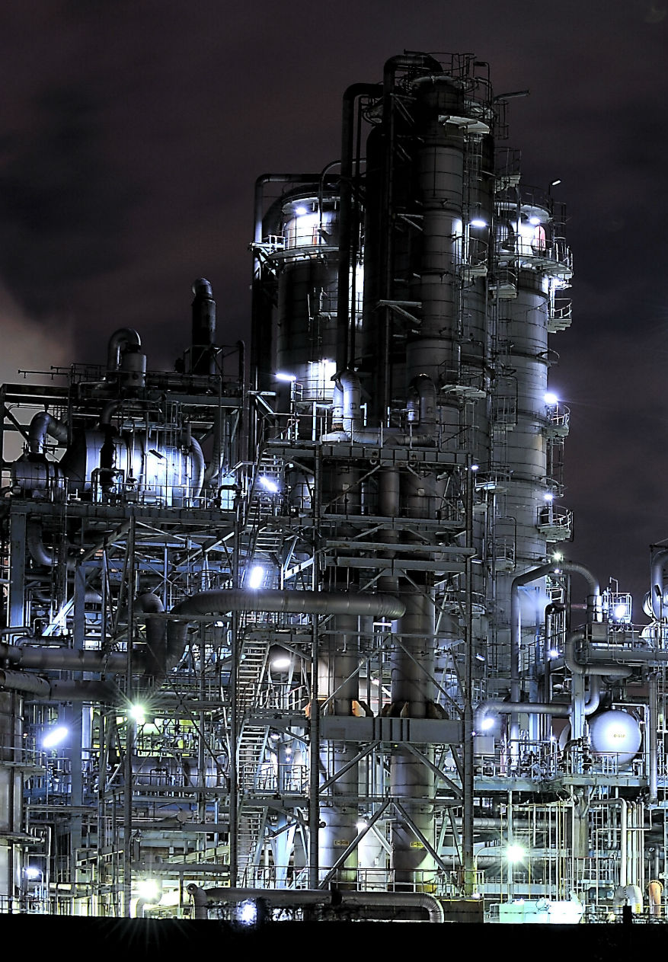
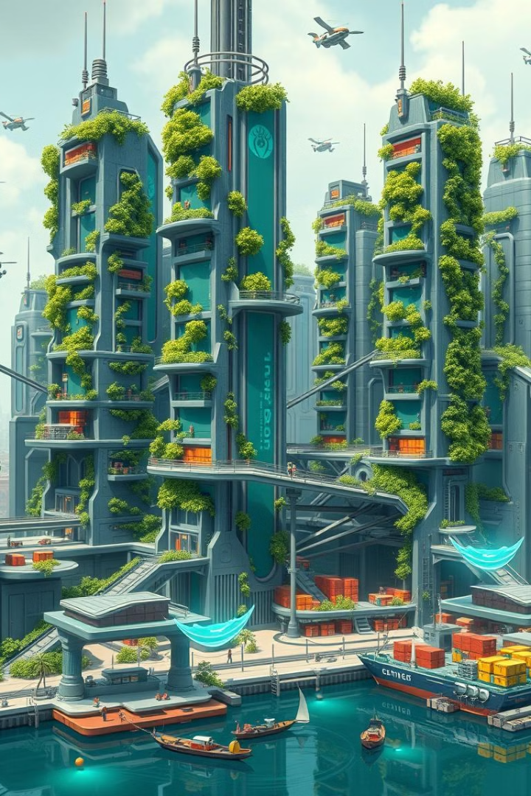
Causes of Air Pollution in Dilovası
1
Industrial Plants
Factories in Dilovası, particularly in the chemical and metal industries, release significant amounts of greenhouse gases and harmful particulate matter. Emissions from combustion processes severely impact the region's air quality.
2
Transportation
Both sea and land transportation contribute to air pollution in Dilovası. Heavy-duty vehicles and sea traffic emit pollutants into the atmosphere.
3
Fossil Fuels for Heating
During winter months, the use of fossil fuels (coal and diesel) for heating exacerbates air pollution in Dilovası.
4
Agriculture and Waste Burning
The use of chemicals in agriculture and uncontrolled waste burning further degrade air quality in Dilovası.

Slide 3
Environmental Impacts of Air Pollution
Health Impacts
Water and Soil Pollution
Impact on Ecosystems
Residents of Dilovası face respiratory diseases such as asthma, bronchitis, and lung cancer. Air pollution poses a greater threat to children and the elderly.
Air pollution contaminates water sources and soil. Pollutants mix with rain, leading to soil and water contamination, which affects agricultural products.
Vegetation is directly affected by pollution, with certain plant species suffering. This negatively impacts the region's biodiversity.

Slide 4
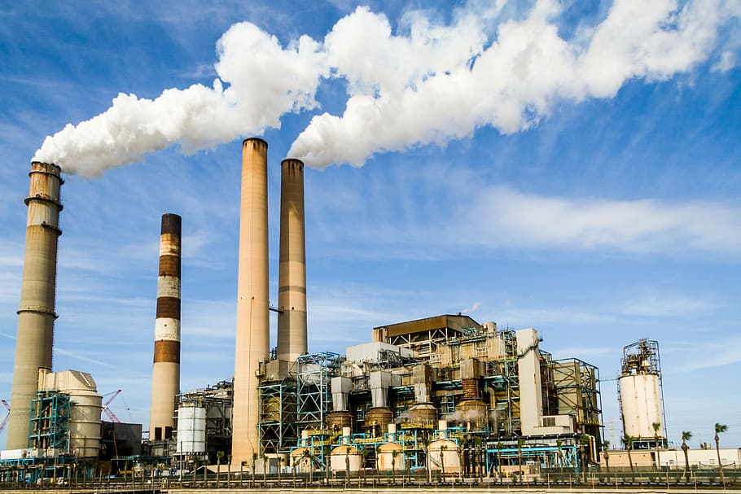
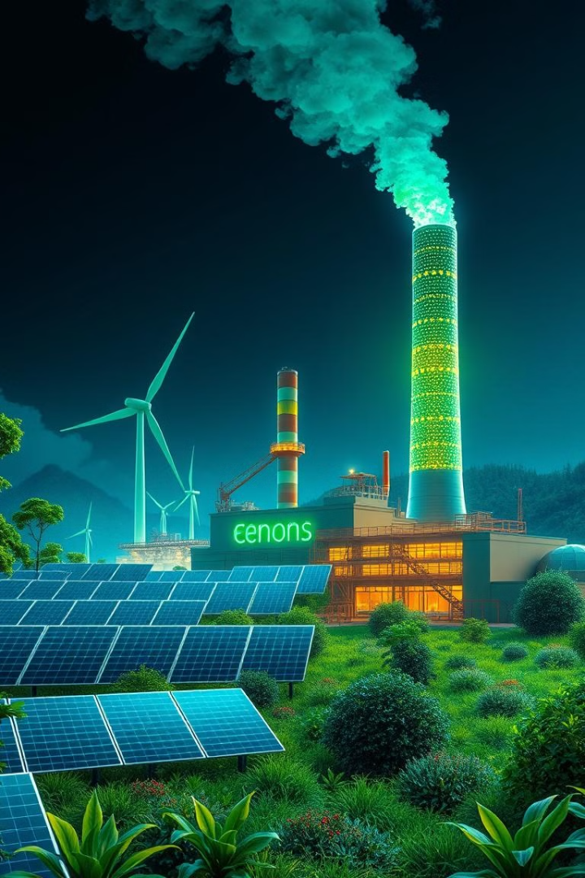
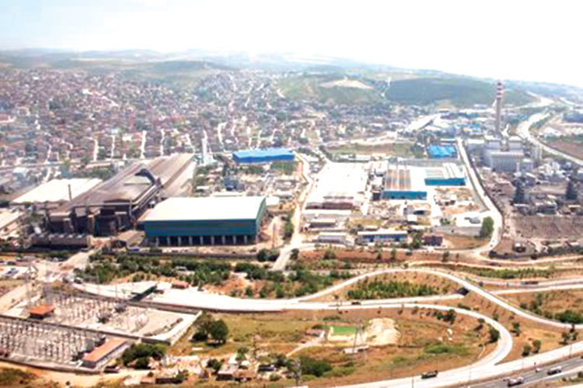



Transition to Green Energy
Encouraging the use of renewable energy sources (such as solar and wind power) instead of fossil fuels in industrial plants can effectively reduce pollutant emissions. This transition to green energy is crucial for mitigating air pollution in Dilovası.
Reduced Emissions
Renewable energy sources emit significantly fewer pollutants compared to fossil fuels.
Improved Air Quality
Transitioning to green energy can lead to cleaner air and a healthier environment for residents.
Sustainable Development
Green energy promotes sustainable development and reduces reliance on finite fossil fuel resources.

Slide 5
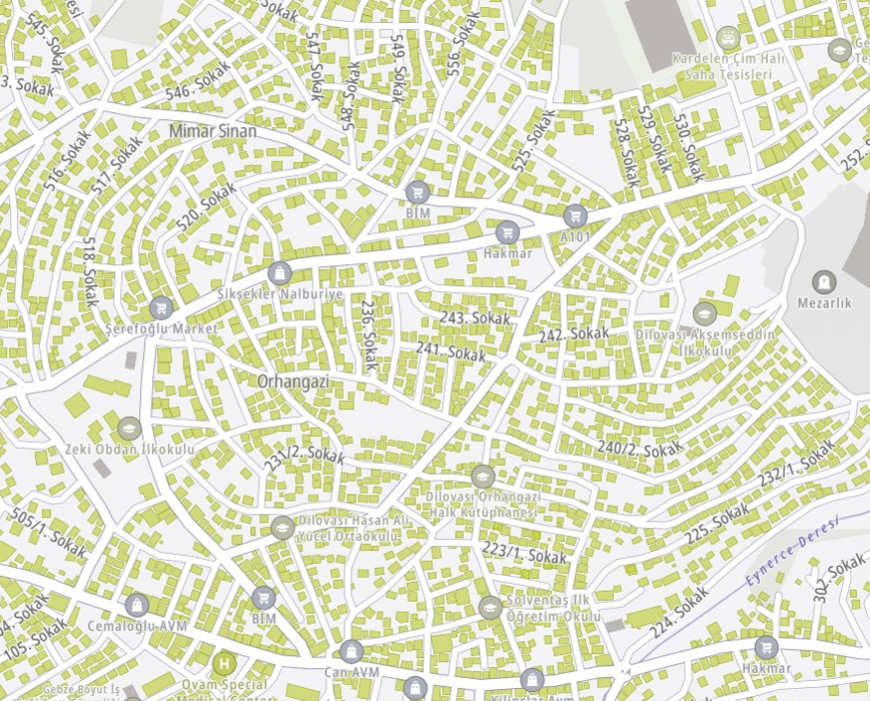
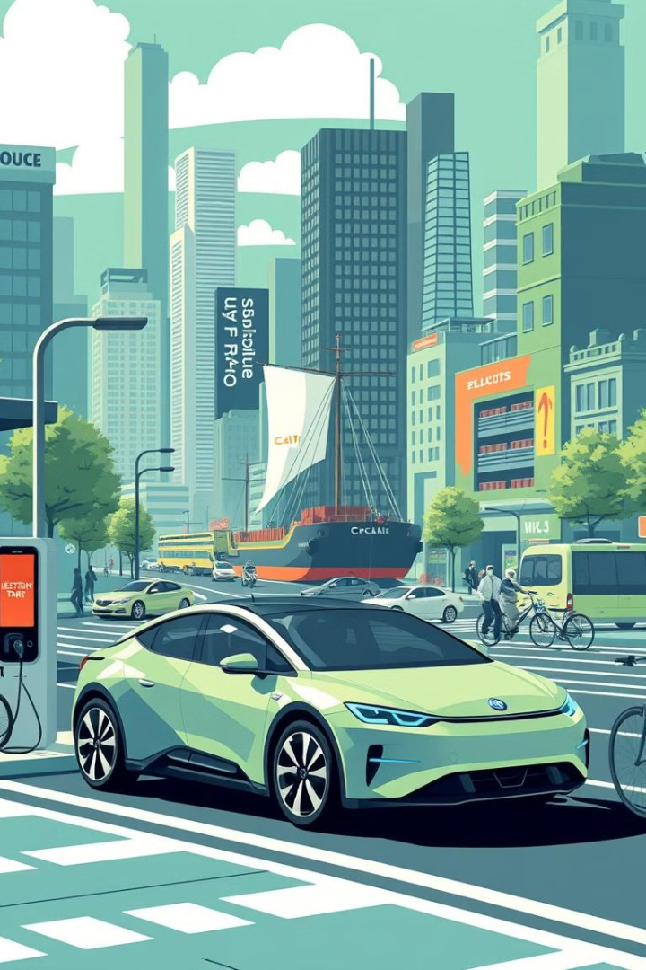

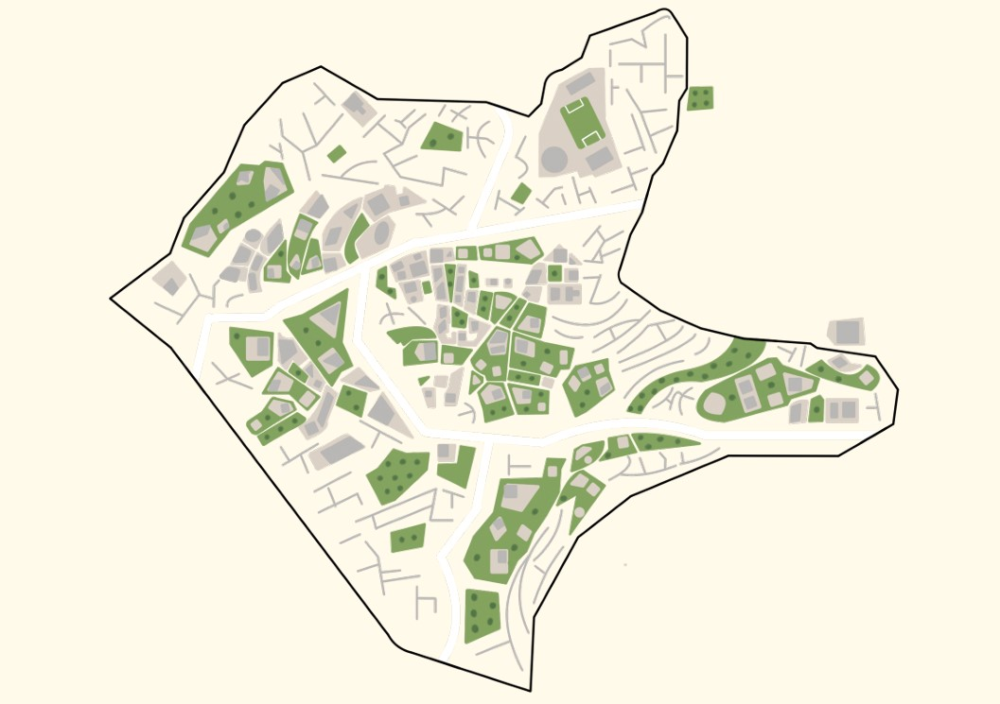



Community Mapping
Community Mapping allows local communities to visually represent environmental challenges, enabling a shared understanding of issues like air pollution. This participatory approach helps identify problem areas and creates a pathway for collective action.
Steps of Community Mapping
Identify Pollution Sources: Through data collection and community input, major industrial sources of pollution are mapped.
Map Impacted Areas: Affected regions, particularly residential zones near industrial sites, are visually highlighted for further analysis.
Develop Action Plans: Based on the mapped data, sustainable solutions like cleaner technologies and stricter regulations are proposed.
Monitor Progress: Continuous mapping tracks improvements, ensuring accountability and long-term reduction in air pollution.

Slide 6
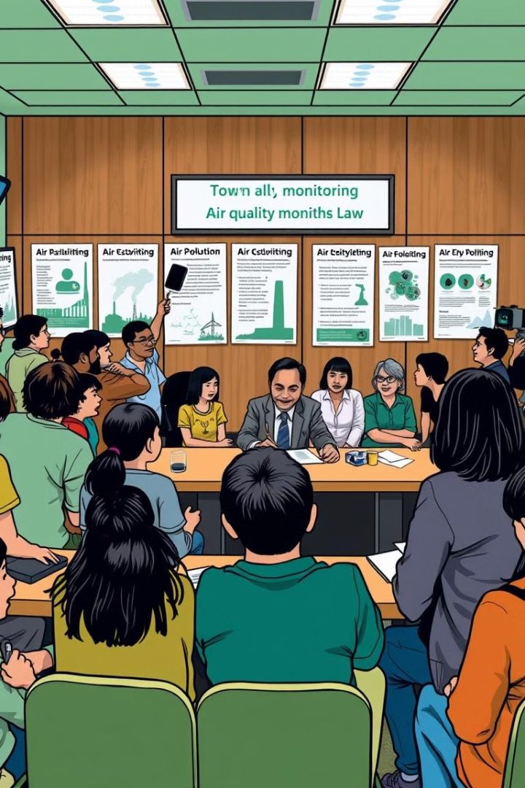


Public Awareness and Stricter Regulations
Educating the local community about the effects of air pollution and the measures that can be taken is crucial for fostering a sense of responsibility and encouraging participation in environmental protection efforts. Implementing stricter regulations and monitoring industrial companies' environmental impacts are essential for ensuring compliance and reducing pollution.
Public Awareness
Raising awareness about air pollution and its impacts can empower individuals to make informed choices and advocate for change.
Stricter Regulations
Implementing stricter regulations and monitoring industrial emissions can ensure compliance and reduce pollution levels.

Slide 7
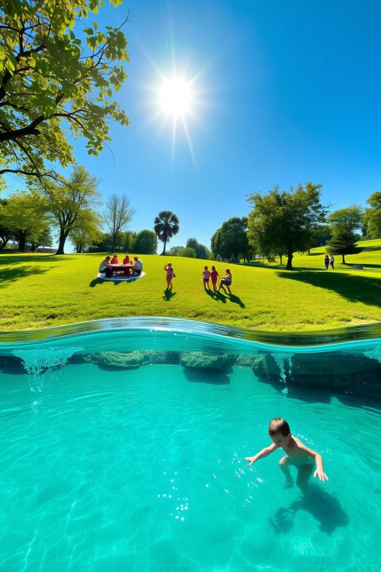
Conclusion
Air pollution in Dilovası is a serious environmental problem caused by industrial activities in the region. However, with the development of innovative solutions and the implementation of proper policies, both the environment can be protected and the quality of life for the local population can be improved. Measures such as transitioning to green energy, transforming transportation systems, and raising public awareness can contribute significantly to solving this critical issue.

